Slide 1
FRAMED
OCA’s Digital Transformation Strategy, framed within six guiding principles

Slide 2
Flexible
Relevant
Accessible
Measurable
Engaging
Data-protected
F
R
A
M
E
D

Slide 3
Flexible
R
A
M
E
D
Only technologies and content which can be experienced on a range of devices will be procured or developed.
Learning materials must be available in a range of formats to suit the needs of the learner.
Technologies capable of improving flexible working patterns and practices will be introduced.
Digital tools capable of meeting a variety of current and future learning needs will be prioritised.

Slide 4
F
Relevant
A
M
E
D
Technologies will only be developed or procured to meet a predefined need.
Periodic reviews of technologies will be conducted to ensure tools in use continue to meet their defined purpose.

Slide 5
F
R
Accessible
M
E
D
Digital tools and the content they’re used to create must be accessible to WCAG 2.0 levels.
The views of Accessibility representatives amongst the student community will be sought prior to the adoption of new digital tools.
Periodic accessibility audits will be conducted to ensure the college meets the access needs of its diverse student population.

Slide 6
F
R
A
Measurable
E
D
Digital tools must contain an ability to measure outputs to establish their continued relevance against their established use-cases.
All learning activities must be measurable, to provide data on learning outcomes, and student progression, enabling proactive interventions to take place.
Data obtained must be sharable, allowing the free-flow of information between OCA and UCA to provide opportunities for blended learning partnerships.

Slide 7
F
R
A
M
Engaging
D
Digital tools must be capable of engaging their intended audiences. An unused tool is an irrelevant tool.
Content created through digital authoring tools must be capable of engaging its consumers, and be capable of demonstrating that fact through measurable data.
Through careful selection of relevant tools, a provision for various forms of engagement will be provided, from group video sessions, to collaborative opportunities, and empowerment through delegated ownership.

Slide 8
F
R
A
M
E
Data-protected
Digital tools’ data protection attributes must be in line with GDPR regulations.
Any digital tool developed in-house, must consider the protection of data from the outset of and throughout its development.
Any digital technology put to new use must first be reviewed against GDPR requirements.

Slide 9

Example 1: OCA Learn draft demo
A draft demo of OCA Learn VLE, for eventual use on oca.ac.uk as an introduction to how OCA study works.

Slide 10
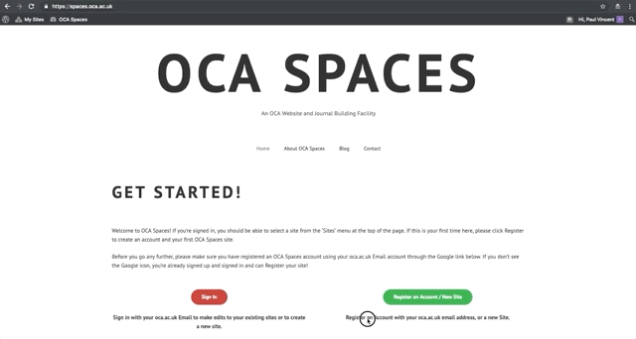
Example 2: OCA Spaces
A draft demo of OCA Spaces, an OCA-hosted Wordpress Multisite environment currently being piloted through the MA Fine Art 2018 cohort for templated Learning Journals, and by the TEL Team (https://spaces.oca.ac.uk/telteam) for a central repository of Educational Technology guidance.

Slide 11
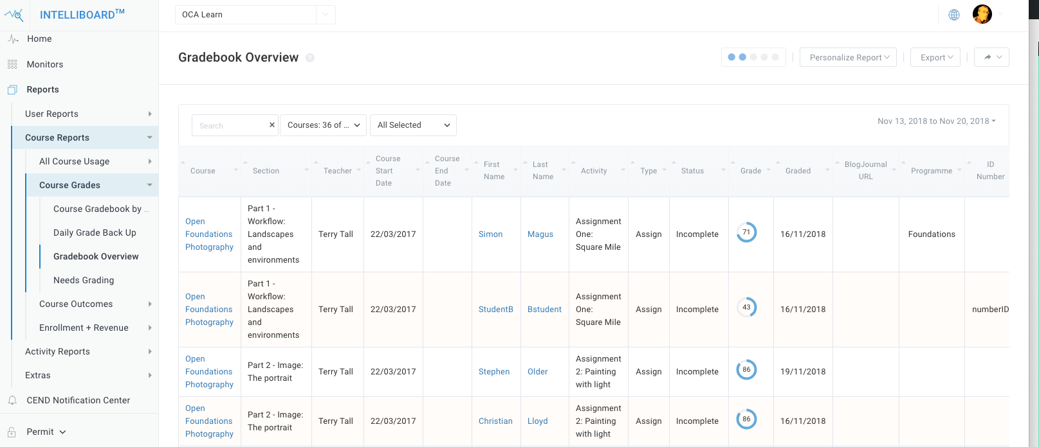
Example 3: Intelliboard
Intelliboard has been selected as a Learning Records Store. Staff and Tutors can access a dashboard of Monitors and Reports which contain detailed data on their students’ progress (or lack thereof.)
Automated notifications can also be issued based upon given data thresholds.

Slide 12



Example 3: Digital Capabilities Training
Adoption of new Digital Technologies is critical to the success of Digital Transformation, with that in mind, a series of monthly Digital Capabilities Training Workshops are soon to be commenced. These sessions will, when relevant and appropriate, be open for remote participants such as tutors and students to join via Zoom.

